Slide 1
INTRODUCTION
In the Beginning
The Story of Our Universe
Robert M. L. Baker, Jr.
This story is for the non-cosmologist. For the person who would just like to consider a different, very novel way to view the beginning of our Universe from a less detailed scientific perspective. Instead, learning from this simpler, informal, almost comedic and interesting perspective of the following presentation.
Notes:
Sent: Saturday, May 15, 2021 12:43 PM To: Robert M. L. Baker, Jr., PhD; Bonnie Baker; Alexander Fell; *Robin Fell* Cc: Kip Thorne; Dr. Thomas F. Rosenbaum; Ed Stolper
Subject: Fwd: FW: New Rollout Theory of the Universe
bob,
I am enthralled by this theory of decelerating time and think it would imply a universe much older than 13.7 or .8 billion years.
Let's just extrapolate back the Observations of 21 cm Hydrogen ...it could be 1-200 billion years!!??
This theory is not TOO much sillier that Dark Matter and Dark Energy.
I remember you presenting this Rollout theory (with rollouts!) at a California Club breakfast years sooner than in Austin, Texas, on Sunday, February 18th,2018, Fred

Slide 2
Contemporary theories of our Universe, such as the Friedmann-Lemaître-Robertson-Walker (FLRW) model of the cosmos, assume that time marches on at a uniform, constant pace from its very beginning
But What If That Is Not the Case?
First, let us consider TIME itself!
The following slides are abstracted from: Robert M L Baker, Jr. “A Theory of Our Universe,”
Journal of High Energy Physics, Gravitation and Cosmology
Volume 6, No. 4, October, 2020

Slide 3
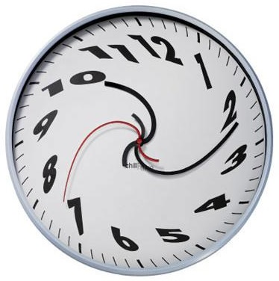
Since the dawn of civilization on Earth, “time” has been an essential concern of humanity. Einstein proposed a revolutionary concept that time need not move uniformly and regularly, but that its “rate” could appear to change!

Slide 4
Suppose, as a Working Hypothesis, Time Moved Really FAST relative to today’s clocks in the very Beginning of our Universe
Note that if a clock (time) moves fast, then the seconds, minutes, hours, days and years are shorter! Let us see how our Universe has progressed
Notes:
I have proposed (working hypothesis) that if time were running really fast in our early Universe, then the speed of light measured there would not be over the “speed limit” of c or light! But, no matter what happened in our early Universe, I suggest that time was moving extremely fast back then and is now slowing! By Occam’s razor the concept of changing the speed of time is SIMPLER to visualize (we all are familiar with our watches running fast or slow) than Guth’s “positive vacuum energy density” and therefore I believe it to be preferable.
By the way, a working hypothesis is defined (Wikipedia) as a hypothesis that is provisionally accepted as a basis for further research in the hope that a tenable theory will be produced, even if the hypothesis ultimately fails or is significantly modified (Isaac Newton’s Principia Mathematica, as significantly modified by Einstein, is an example). It is essentially an encouragement for further research and analyses.

Slide 5
Development of our Universe involving the speed of time starting out extremely fast with apparently short hours, minutes and years. Years in the very early universe could appear today as microseconds!:
Possibly 100 billion very short “years” since Planck time
101.0 billion “years”
101.2 billion “years” (a bit shorter than today’s) - galaxies appear to rotate faster
113.8 billion of today’s years
Notes:
In this slide my working hypothesis is shown graphically.
José M. M. Senovilla, of the University of the Basque Country, Spain, in 2008 theorized that the expansion of our Universe is an “illusion” and actually is the result of the higher speed of time during the period when the light left the stellar structures in the past,: “… we are fooled into thinking that the expansion of the Universe is accelerating because time itself is slowing down”. So that according to Senovilla, the speed of time may be related to the “illusions” of dark matter and dark energy estimates. The reason that we have not been able to detect dark matter may just be that it does not exist!

Slide 6
The Cosmic Microwave Background (CMB) is essentially Black-Body radiation from what has been called a “snapshot” of the beginning of our Universe.
What do see when all the frames of a movie are displayed at one time? You get BLACK -- literally a “Black Body” You see a faint cosmic background radiation filling all space – literally billions of years piled upon billions of years of faint faraway stars!
We view it not as a snapshot, but a very compressed time segment of our Universe. It is like the frames of a movie all piled up together one frame on top of the other!

Slide 7
Extreme “Red Shift”
In 1929, Edwin Hubble discovered that our Universe is expanding, with most other galaxies speeding away from us. Light from these galaxies is shifted to longer and redder wavelengths – in other words, their light is red-shifted, a result of the stellar increase in stellar separation speed involved in the expansion of our Universe.
We view the CMB with radio telescopes: the shift to even longer wave lengths or lower frequencies of 3 × 10¹¹ to 3 × 10⁸ Hz is an “extreme red shift”! We believe it is due to the apparent high separation speed of stars and galaxies caused directly by the much higher speed of time as the beginning of our Universe is more closely viewed; for example, as the Cosmic Microwave Background is viewed!

Slide 8
Cosmic Gravitational Wave Background (CGWB)
According to the Rollout Theory, Black-hole and neutron-star mergers may APPEAR to progress faster in the past due to the higher speed of time then.
Because it is proposed that our Universe is much older than its 13-billion-year observed part, there may be MANY INDIVIDUALY-UNOBSERVED black-hole and neutron-star mergers in the past.
Like the noise detected by Penzias and Wilson, their combined signals, in addition to the extreme red shift, would be perceived as “noise” coming from EVERYWHERE!
Directionality is usually determined by the arrival time of the signals from GW-merger events and for CGWBs the “GW noise” pattern would be perceived as INDEPENDENT of arrival time or direction at all the arrays of active LIGO detectors.

Slide 9
The Beginning Planck Time = √(ħG/c⁵ ) ~ 5.39 × 10⁻⁴⁴ sec and time since then ~ 4.4 × 10¹⁷ sec so now our Universe has completed about 61 orders of magnitude (in 10s) changes in time since the The Beginning! With Terahertz HFRelicGWs on into “infra-Red” GWs we may be able to detect processes to femtosecond (10⁻¹⁵ sec) precision. We could then detect a fictitious star “frame” change below between a star “field” progression over a billion years that today Appeared to take place during only a microsecond!

Slide 10
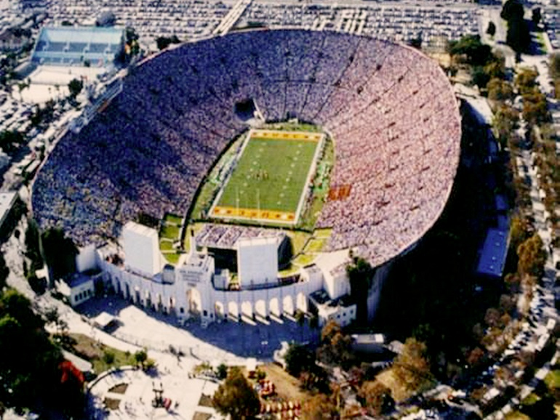
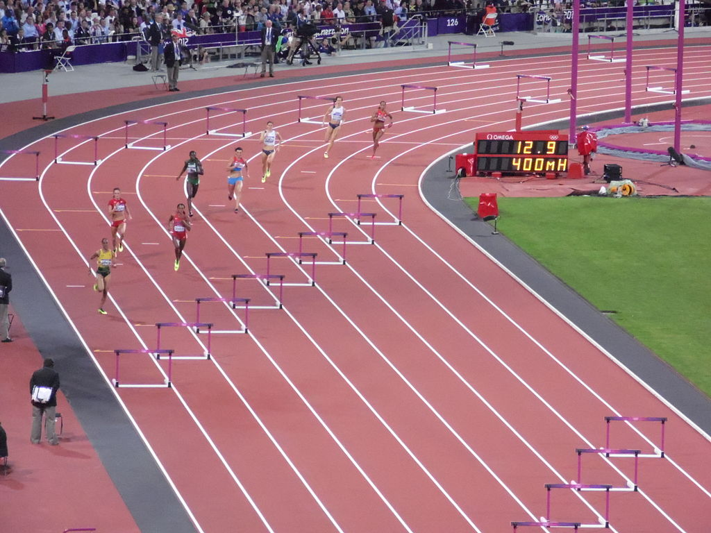
We look back in time several billion years – in actuality we do this when telescopes look at stars billions of light-years away! We see a galaxy. It appears to be rotating faster and a little less spread out than expected. Next we look at an Olympics Games Coliseum on a duplicate Earth (we are pretending here – a thought experiment).
Notes:
This is a thought experiment …” sometimes called a “Gedankenexperiment” by smart German Physicists!

Slide 11
There we see a little track with little runners going around – wow! They make 4 circuits (mile) in a few seconds by my wristwatch! Everything a little faster and a little smaller or less spread out like the galaxy! Now I look at the weight-lifting pavilion. There are little weight lifters also moving quickly and pushing up little bar bells. The laws of physics appear to be as usual to them (special, general relativity, Schrödinger equation, etc. unchanged). A fast-moving miniature World with objects getting closer together – “density” increasing as we go further back in time!.
Notes:
A fast-moving miniature “World”. All the laws of Physics: special, general relativity, etc. remain completely unchanged!

Slide 12
New Theory of our Universe
The idea is very simple: our Universe starts out at “time zero” (or Planck Time) and all the coordinates of space (x ,y, z or East, North, Up) are also “zero” (or of Planck Length) and then all these four dimensions, of what Einstein called "spacetime" begin to ROLL OUT and grow and grow extremely fast initially and then slow down like an old clock–and the “density” of our Universe decreases as spacetime rolls out!

Slide 13
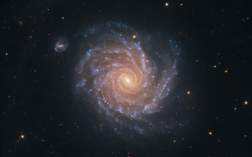
Galaxies APPEAR to rotate faster in the past if time was moving faster then. Astronomers have attributed this to a lot more mass or matter in them that holds them together so they can rotate fast and not pull apart. They call it “Dark Matter”
Time Faster Early Universe
Today'sTime Today’s Universe

Slide 14
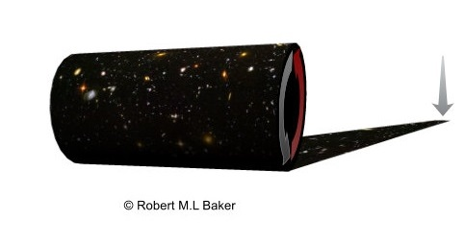
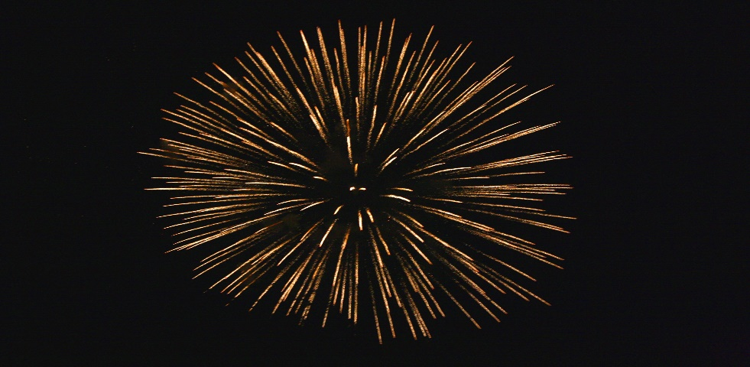
New Theory of our Universe
"Big Bang" Alan Guth
"...that the nascent Universe passed through a phase of exponential expansion soon after the Big Bang, driven by a positive vacuum energy density."
"Big Rollout" R. M L Baker, Jr.
"… that our Universe Rolled Out with time moving extremely fast from time zero and with infinitesimally small dimensions and both of these spacetime coordinates growing."
Notes:
Here I describe the “Big Rollout" of our Universe with space dimensions growing from a tiny Planck Length and the speed of time (similar to a wristwatch running fast or slow) moving very fast as it commences at a tiny Planck Time and slowing down.

Slide 15
The galactic stars dominate as viewed near to the galactic center and also block many of the earlier & more distant spacetime stars. Further out, towards the periphery of a galaxy, there is an opposite effect in which earlier & more distant spacetime stars dominate. Since the later earler & more distant spacetime stars appear to have a larger speed than the galactic stars, the velocity curve below tends to rise up and then roughly level out as viewed from our Earth and may be observational proof of the Rollout Theory.

Slide 16
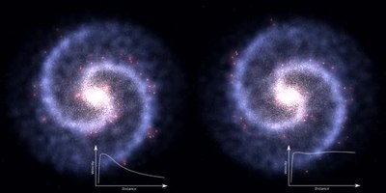
We will consider the close-by Messier 33 Galaxy from two different perspectives: Left: All stars moving at high speeds (due, I propose, to the higher speed of time) from earlier & more distant spacetime have been blocked by the galaxies'’ stars, ONLY the speed of stars from the galaxy are measured on the small graph of star speed vs. distance at the left-hand bottom. Right: ONLY stars moving at high speeds (due, I propose, to the higher speed of time) from earlier & more distant spacetime , EXCEPT for blockage of them by galactic-center stars, are measured on the small graph of star speed vs. distance at the right-hand bottom.

Slide 17
How to measure the rotational speed of a galaxy:
To measure the rotation of a galaxy, observations must take into consideration the average shift of the spectrum of the galaxy. This will almost always result in a net spectral redshift for galactic stars, since it includes the expansion of the universe, and also our solar system’s motion toward or away from the galaxy we are observing (the rotation of our planet, our orbit around the Sun, the Sun’s motion around the galaxy, and the galaxy moving through our Universe). The more rapidly the galaxy rotates the more the red shift.
Distant stars in spacetime, further and older than a given galaxy, show a larger red shift and higher speed the faster time is moving in their spacetime region. Therefore, if mistaken for galactic stars, then an erroneous higher speed and galactic rotational rate is mistakenly observed for the galaxy.

Slide 18
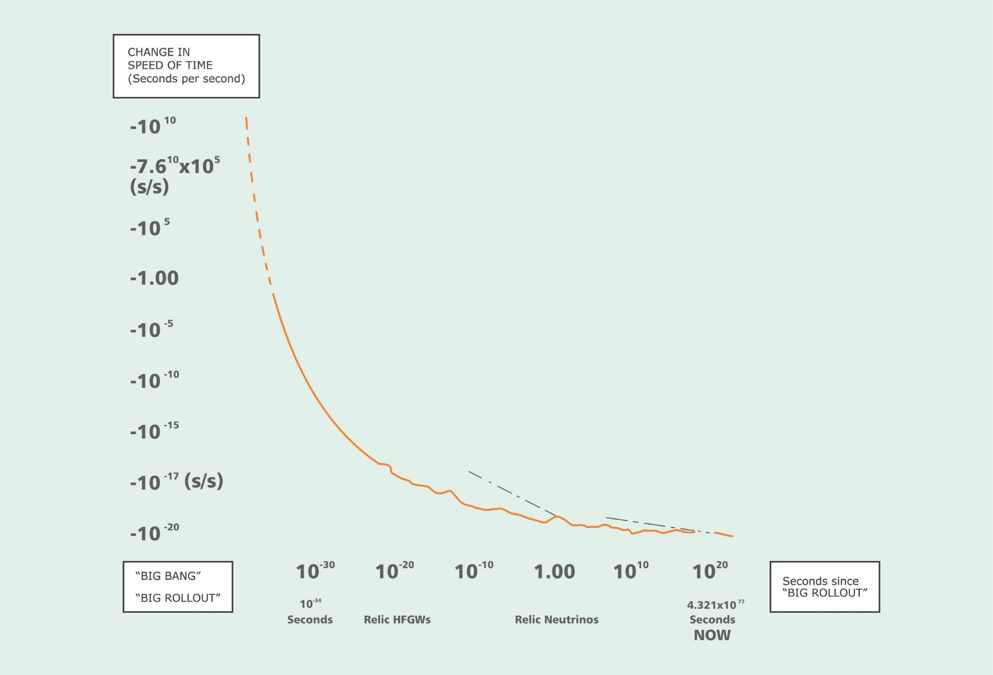
Notional graph of the change-of-speed-of-time variation with today’s time dimension. Notice different slopes (tangents) and irregularities. Time was very fast in the past near the beginng of our Universe and has been slowing so that faraway stars appear to have higher speeds.
From Fig. 3, A WORKING HYPOTHESIS ON THE MUON-DECAY TIME SHORTENING by R. M L Baker, Jr. , Journal of Space Science and Technology, No. 3, 2019
Notes:
Although so far not statistically significant, my studies of Muon decay time suggest that at the current time (NOW at 4.3x1017 seconds after the start or Planck time), time is still slowing at the rate of about 13 picoseconds per year. A picosecond, ps, is a trillionth of a second, or 0.000,000,000,001 seconds. On the graph (left ordinate) it would amount to minus 13ps/31,540,000,000,000,000,000ps per year equals – 3.7 x 10-18 picoseconds per picosecond or seconds per second. Awfully small BUT no matter what size it is we would not notice it in our daily lives or in physics laboratories. For example, the acceleration of gravity and the speed of light would remain unchanged!
We look back in time several billion years – in actuality we do this when telescopes look at stars billions of light-years away! We see a galaxy. It appears to be rotating faster than expected. Next we look at an Olympics Games Coliseum on a duplicate Earth (we are pretending here – a thought experiment). There we see a little track with little runners going around – wow! They make 4 circuits (mile) in a few seconds by my wristwatch! Fast like the galaxy! Now I look at the weight-lifting pavilion. There are little weight lifters also moving quickly and pushing up little bar bells. A fast-moving miniature World.
Although so far not statistically significant, my studies of Muon decay time suggest that at the current time (NOW at 4.3x1017 seconds after the start or Planck time), time is still slowing at the rate of about 13 picoseconds per year. A picosecond, ps, is a trillionth of a second, or 0.000,000,000,001 seconds. On the graph (left ordinate) it would amount to minus 13ps/31,540,000,000,000,000,000ps per year equals – 3.7 x 10-18 picoseconds per picosecond or seconds per second. Awfully small BUT no matter what size it is we would not notice it in our daily lives or in physics laboratories. For example, the acceleration of gravity and the speed of light would remain unchanged!
We look back in time several billion years – in actuality we do this when telescopes look at stars billions of light-years away! We see a galaxy. It appears to be rotating faster than expected. Next we look at an Olympics Games Coliseum on a duplicate Earth (we are pretending here – a thought experiment). There we see a little track with little runners going around – wow! They make 4 circuits (mile) in a few seconds by my wristwatch! Fast like the galaxy! Now I look at the weight-lifting pavilion. There are little weight lifters also moving quickly and pushing up little bar bells. A fast-moving miniature World.

Slide 19
WHAT ABOUT THE THREE SPACE DIMENSIONS ?
As an example of that fast-moving miniature world consider a 4-minute Miler and the apparent decrease in the space dimension during a faster speed of time.
Regular Time Today:
Takes 4 minutes Today:
Suppose clocks 60 times faster 5 Billion years ago takes 4 hours then?:
Something is wrong unless the mile appeared 60 times shorter then (the stopwatch hand as seen today really spinning rapidly around):
Again the 4-minute Miler Takes 4 min

Slide 20
How is the change in space dimensions related to the change of the time dimension.
AT THE BEGINNING
(change in the space dimensions) = (speed of light) x (change in the speed of time)
The speedy photon’s speed, c = 186,282.397 miles per second and is the same in all frames of reference according to Einstein's special theory of relativity
Smaller second offset by smaller “standard” mile! After time “zero” or Planck time, the speed of time slows and the space dimension grows from the infinitesimal Planck length to today’s. Both changes (slow/grow) in the same proportion to insure the constancy of the photon's speed of light!
Notes:
My working hypothesis in a nutshell: A big rollout of spacetime from vanishingly small space dimensions (such as Planck length) and almost infinitely fast speed of time (near “zero” or Planck time) to today’s values; testable by detection of relic high-frequency gravitational waves, is speculated. The Planck Length is the scale at which classical ideas about gravity and space-time cease to be valid, and quantum effects, as described by Max Planck, dominate. This is the quantum of length, the smallest measurement of length with any meaning. And roughly equal to 1.6 × 10-35 meter or about 10-20 times the size of a proton! Planck Time is time it takes a photon to move across a Planck length or 5.39 × 10 −44 seconds. It is the smallest unit of time you can conceive! Note also that the infinitesimal Planck time interval is analogous to the extremely brief starting pistol’s sound time interval that signals the beginning of a race and, analogously, the beginning of time.

Slide 21
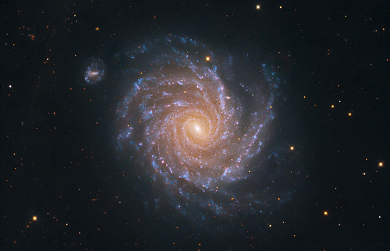
At the “beginning” the watch of time cannot be “read” since it is within the fog of quantum-mechanical frenzy at small scales and likewise the dimensions of space are undefined in this QUANTUM FOG. It is similar to the “Fog of War” – you cannot know exactly what is going on in it!
? ?

Slide 22
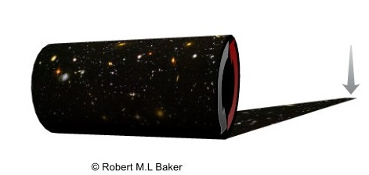
At the very beginning of our Universe the “Big Rollout” in space and time, spacetime is from the shortest length, Planck Length, (the smallest measure of length because shorter than it, quantum effects or fog dominate and it becomes meaningless to consider exact values of measurements) and the shortest meaningful measure of time, Planck Time (the time it would take a photon travelling at the speed of light to cross a distance equal to the Planck Length) commences.

Slide 23
Started out like a tiny newborn baby One Planck Time Old and
One Planck Length Long.
To me, and a very few others, introducing a completely fictitious new and totally unobserved “Dark Matter” is “silly”. As Einstein stated “The only element in the universe more common
than hydrogen is stupidity.”
Comparing a newborn baby to our Universe’s beginning is not silly. Newborn babies start out shaking and crying (like the baby was in the quantum-mechanical “fog”) and as they mature their dimensions grow. As they pass adulthood they slow down, much as I propose our Universe slows down!

Slide 24
Who shakes and we give it a rattle! (I gave the first public presentation of my concept as an invited Poster Presentation at The Annual Meeting of the American Association for the Advancement of Science (AAAS) in Austin, Texas, on Sunday, February 18th, 2018, after a session on Dark Matter Detectors.)

Slide 25
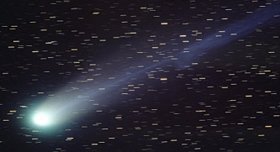
AND IT ROLLS OUT!!!!
Shake Rattle and Roll! Bill Haley and his Comets

Slide 26
FOR YOUR CONSIDERATION
It is my hope that you will profit from this presentation. That you will understand the concept of the slowdown of the speed of time and the growth of space as spacetime rolls out. That there is no requirement for Dark Matter and Dark Energy – neither of which have been observed. And, finally that the study of the growth of our tiny “baby” Universe can best be studied by means of the detection of very high-frequency gravitational waves. Certainly my theory will be proved or falsified by that detection.
Notes:
Please let me know your thoughts here and thank you all so much for listening.

